Slide 1
CSS 3 Part II: Vendor Prefixes, Box Models, Inherited Properties, Browser Default Styles, Layouts (Float Layout, FlexBox Model, CSS Grid Layout, Multi-column layout), Media Queries, CSS Effects
Vyacheslav Koldovskyy Last update: 29/09/2017

Slide 2
Agenda
UI design
Traditional CSS Box model
Block-level and inline element
Parent/child relationships
Vendor prefixes
CSS Flexbox Box model
CSS Grid Layout model

Slide 3
Vendor Prefixes
CSS3 specification is still in draft format and undergoing modifications
Need to use vendor prefixes with several CSS3 constructs
Internet Explorer uses the -ms- prefix.
Firefox supports the -moz- prefix.
Chrome and Safari support the -webkit- prefix.
Opera supports the -o- prefix.
Notes:
Tip: Add your own speaker notes here.

Slide 4
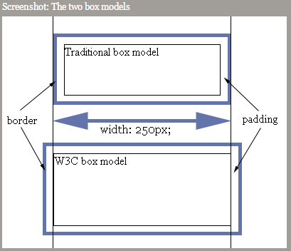
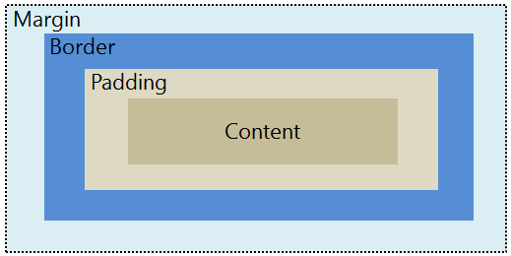
Two CSS box models
Box models
In the W3C box model, the width of an element gives the width of the content of the box, excluding padding and border.
In the traditional box model, the width of an element gives the width between the borders of the box, including padding and border.
By default, all browsers use the W3C box model, with the exception of IE in "Quirks Mode" (IE5.5 Mode), which uses the traditional one.
box-sizing: border-box
box-sizing: content-box
Notes:
Tip: Add your own speaker notes here.

Slide 5
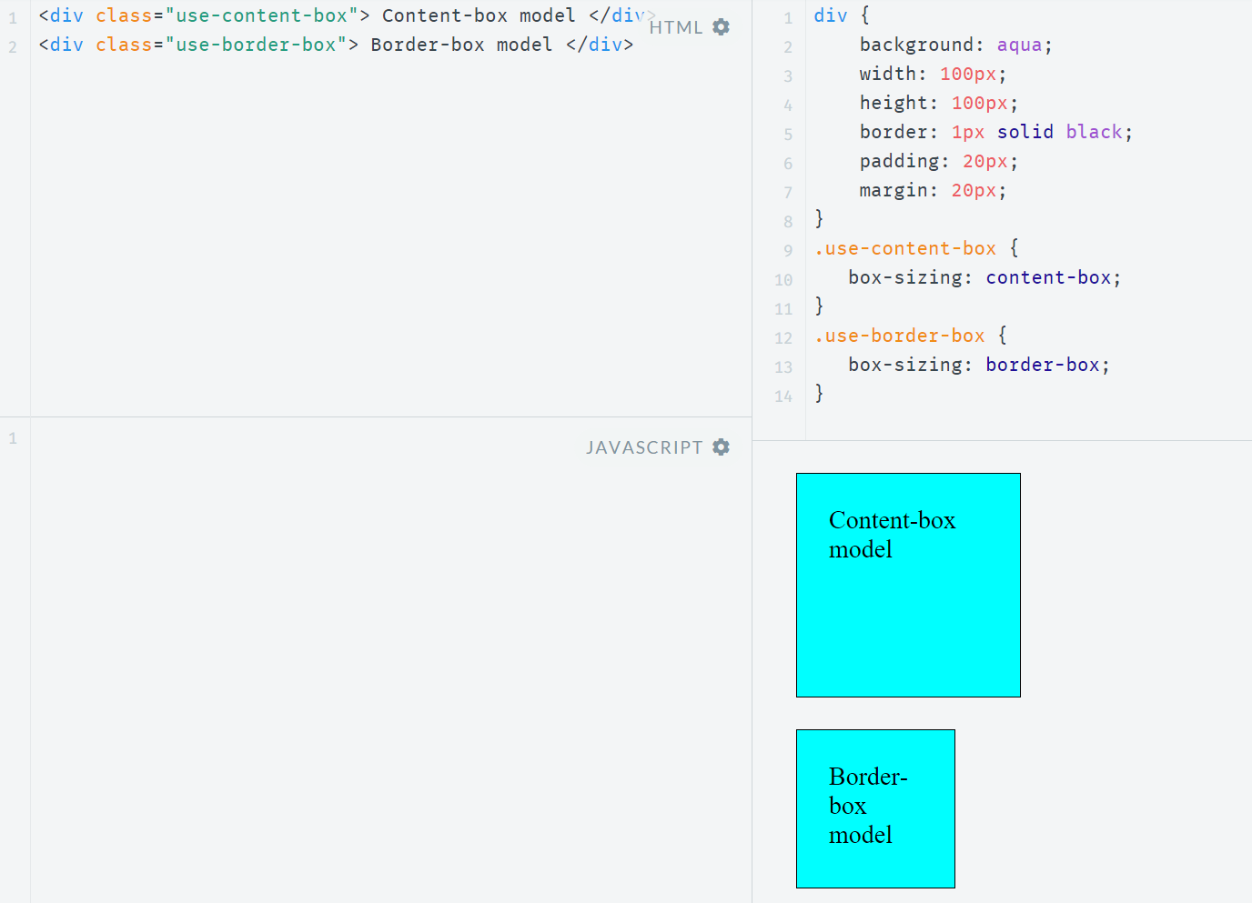
Box model sample
http://jsfiddle.net/koldovsky/e1984en9/1/

Slide 6
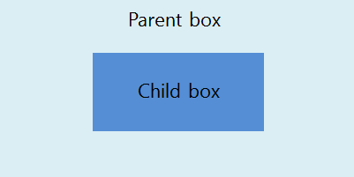
Inherited Properties
A parent box can contain one or more child boxes.
A child can inherit CSS styles from a parent.
Sample inherited property:
p { color: green }
<p>This paragraph has <em>emphasized text</em> in it.</p>
Sample non-inherited property:
p { border: medium solid }
<p>This paragraph has <em>emphasized text</em> in it.</p>
Using inherit property:
/* make second-level headers green */ h2 { color: green; } /* ...but leave those in the sidebar alone so they use their parent's color */ #sidebar h2 { color: inherit; }
Notes:
Tip: Add your own speaker notes here.

Slide 7
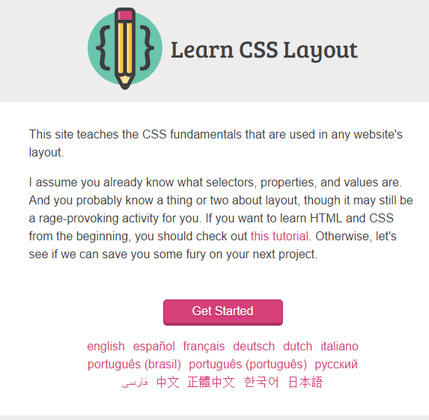
Practice Task:
Explore http://learnlayout.com/ Use different approaches to create leyouts
Notes:
Tip: Add your own speaker notes here.

Slide 8
Browser Default Styles
Web browsers have default CSS styles for HTML elements, consider sample: http://plnkr.co/edit/CHlIR8Yhl0iYwXSIHFWU?p=preview
Also these styles are different for different browsers, so same markup may look different
To ensure same markup looks the same it is recommended to use "reset" or "normalize" stylesheets (second is preferred):
Reset CSS: http://meyerweb.com/eric/tools/css/reset/
Normalize CSS: http://necolas.github.io/normalize.css/
Notes:
Differences between Reset and Normalize
http://nicolasgallagher.com/about-normalize-css/
https://htmlacademy.ru/blog/64

Slide 9
Media Queries
A media query consists of a media type and at least one expression that limits the style sheets' scope by using media features, such as width, height, and color.
Media queries allow to create responsive websites
Details: https://developer.mozilla.org/en-US/docs/Web/CSS/Media_Queries/Using_media_queries
<!-- CSS media query on a link element -->
<link rel="stylesheet" media="(max-width: 800px)" href="example.css" />
<!-- CSS media query within a stylesheet -->
<style>
@media (max-width: 600px) {
.facet_sidebar {
display: none;
}
}
</style>
Sample: http://plnkr.co/edit/xYTDjomz5JNAvpQjt6LZ?p=preview
Some issues with media queries: it's not so simple to reorder blocks

Slide 10
UI Challenges
Developers have used float property for relative positioning of UI elements for years
CSS3 Provides two new options:
CSS3 Flexbox Box model ideal for items that should resize or reposition themselves
CSS3 Grid Layout model good for complex layouts
Notes:
Tip: Add your own speaker notes here.

Slide 11
CSS Flexbox Box Model
Good for controls, toolbars, menus, and forms that resize and reposition automatically when the user changes the size of the browser window
Browser takes the available space into account and calculates the dimensions for the user
Enables relative sizes and positioning
Good tutorial: https://css-tricks.com/snippets/css/a-guide-to-flexbox/
Notes:
Tip: Add your own speaker notes here.

Slide 12
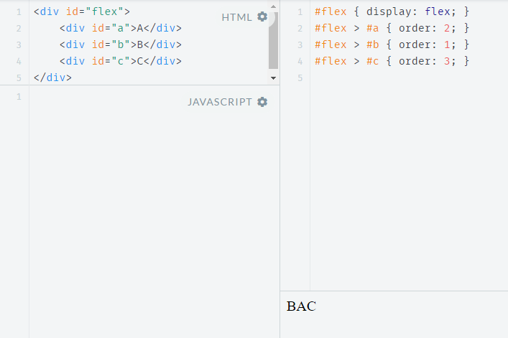
CSS Flexbox Model Reordering Sample
http://jsfiddle.net/koldovsky/jb5h57jw/
Notes:
Tip: Add your own speaker notes here.

Slide 13
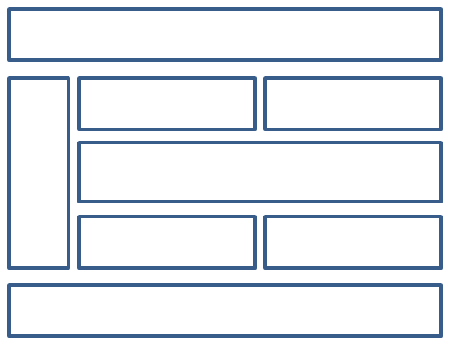
CSS3 Grid Layout Model
Gives developers greater control over complex layouts than the flexbox model
Lets you control the design of sections or entire HTML-based documents using CSS3
Grid layouts use columns, rows, and cells, but you can move blocks of content from one part of page or application to another by moving code lines in CSS
Notes:
Tip: Add your own speaker notes here.

Slide 14
Multi-column Layout
Create columns by dividing text across multiple columns
Specify the amount of space that appears between columns (the gap)
Make vertical lines (rules) appear between columns
Define where columns break
Notes:
Tip: Add your own speaker notes here.

Slide 15
Multi-column Layout
Main CSS properties for creating multiple columns in an HTML document:
column-count: Sets the number of columns
Alternative: Use columns property with column-count and column-width properties
column-gap: Specifies the gap between the columns, known as the gutter or alley
column-rule: Creates a vertical line in the gap between columns and sets the width, style (single or double line, solid, dashed, 3D, etc.) and color of the rule
Notes:
Tip: Add your own speaker notes here.

Slide 16
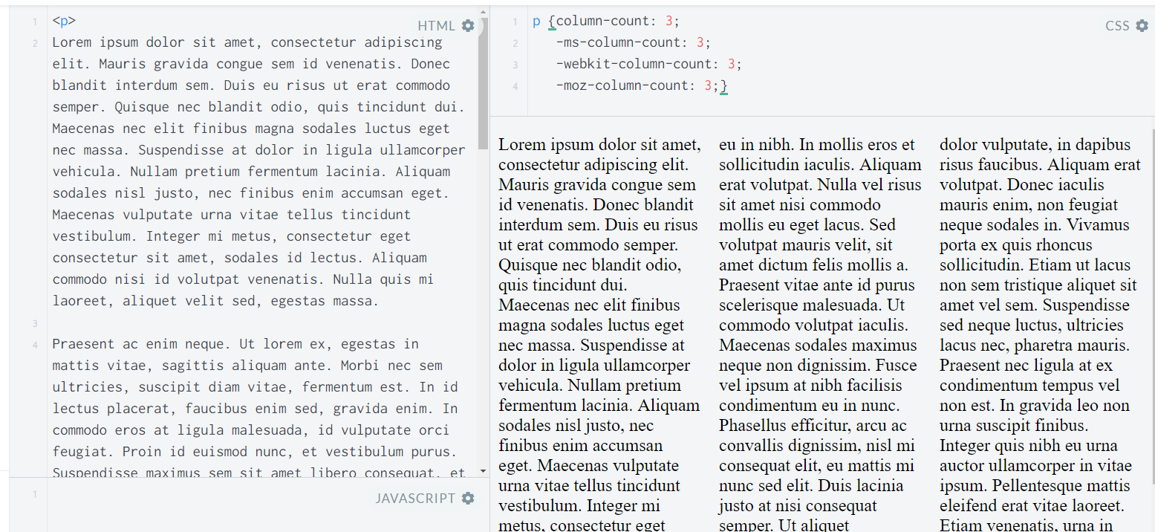
Multi-column Layout Example
https://jsfiddle.net/koldovsky/4k1h7bg0/1/
Notes:
Tip: Add your own speaker notes here.

Slide 17
Hyphenation
The process of connecting two words with a hyphen mark (-) or breaking words between syllables at the end of a line.
CSS3 hyphens property controls hyphenation
Values:
auto: Enables automatic hyphenation of words based on line-break opportunities within words or by a “language-appropriate hyphenation resource”
manual: Enables hyphenation of words based only on line-break opportunities within words
none: Prevents hyphenation
Notes:
Tip: Add your own speaker notes here.

Slide 18
Language Declaration
W3C requires a language declaration for correct automatic hyphenation to occur:
<!doctype html>
<html lang="en-us">
or
<html xmlns="http://www.w3.org/1999/xhtml"
xml:lang="en" lang="en">
Notes:
Tip: Add your own speaker notes here.

Slide 19
border-radius Property
Creates rounded corners around layout elements, like headers, footers, sidebars, graphics boxes, and outlines around images
border-radius is a length, which is usually expressed in pixels or ems but can be a percentage
Notes:
Tip: Add your own speaker notes here.

Slide 20
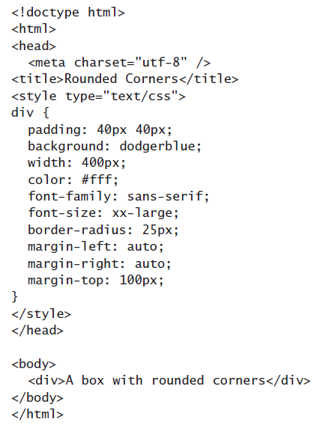
border-radius Example
Notes:
Tip: Add your own speaker notes here.

Slide 21
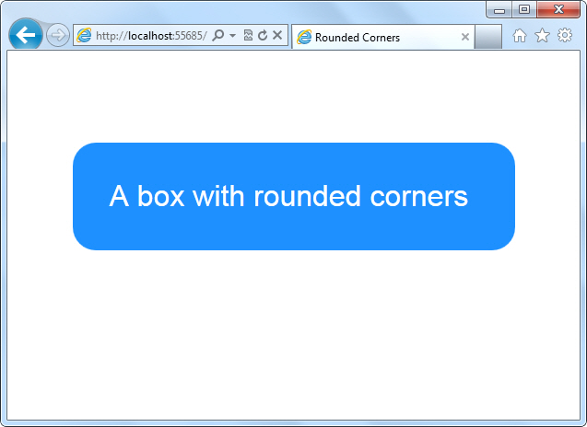
border-radius Example
Notes:
Tip: Add your own speaker notes here.

Slide 22
box-shadow Property
Creates drop shadows around layout elements
CSS syntax for creating a shadow:
box-shadow: h-shadow v-shadow blur spread color inset;
Required: h-shadow and v-shadow attributes set the horizontal and vertical position of the shadow in relation to the box
Optional: blur, spread, color, and inset
Notes:
Tip: Add your own speaker notes here.

Slide 23
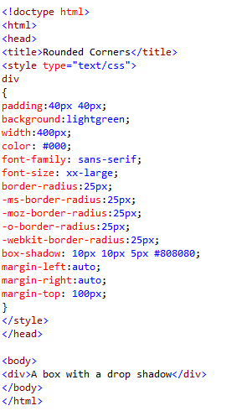
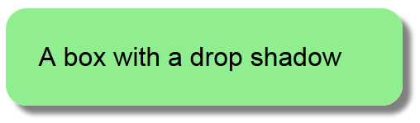
box-shadow Example
Notes:
Tip: Add your own speaker notes here.

Slide 24
Opacity and Transparency
An opaque item does not let light pass through, whereas you can see through a transparent item.
Syntax for applying a transparency to an image or other element:
opacity: value
Value is a floating-point value between 0.0 (100% transparent) and 1.0 (100% opaque)
Notes:
Tip: Add your own speaker notes here.

Slide 25


Transparency Example
Original
With transparency
Photo: © AVTG/iStockphoto
Notes:
Tip: Add your own speaker notes here.

Slide 26
CSS Gradients
Gradient is a smooth change of colors, within the same hue or starting with one color and ending with a different color
Used for subtle shading within backgrounds, button embellishments, and more
Created as methods to the CSS background property
Notes:
Tip: Add your own speaker notes here.

Slide 27

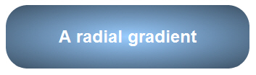
Gradient Examples
Linear gradient: background: linear-gradient(black, white);
Radial gradient: radial-gradient(50% 50%, 70% 70%, #99CCFF, #3D5266);
Notes:
Tip: Add your own speaker notes here.

Slide 28
2D and 3D Transformations
A transform is an effect that lets you change the size, shape, and position of an element.
Transformations use the transform property.
Methods: matrix, perspective, rotate, scale, skew, translate
To see the “action” of a transformation requires JavaScript; using only CSS shows the before and after effects of properties and their values.
Notes:
Tip: Add your own speaker notes here.

Slide 29
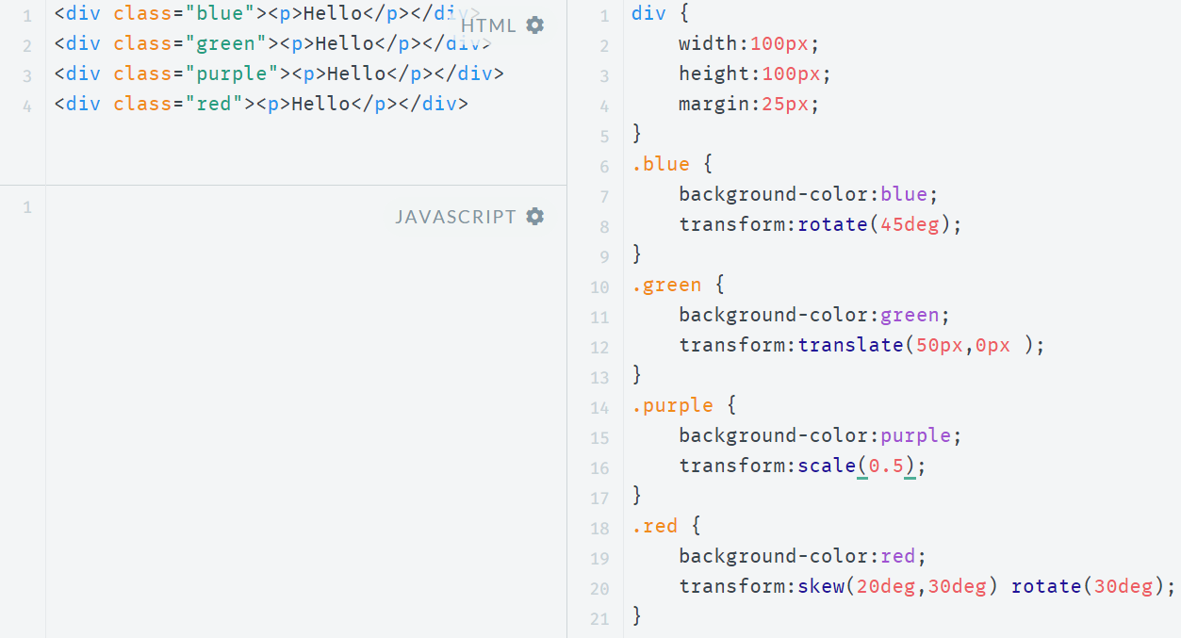
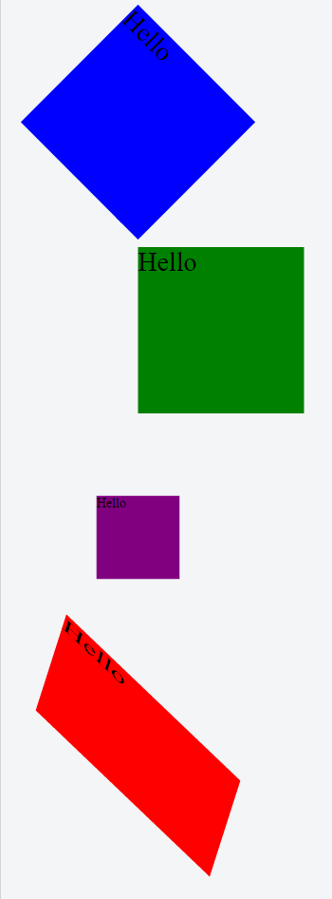
Transformations Sample
http://jsfiddle.net/koldovsky/2m2Zb/36/

Slide 30
CSS Transition
A transition is a change from one thing to another; in CSS, a transition is the change in an element from one style to another.
In CSS3, the action of a transition renders onscreen—no JavaScript is needed!
The transition property requires the CSS property to be acted upon during the transition.
Notes:
Tip: Add your own speaker notes here.

Slide 31
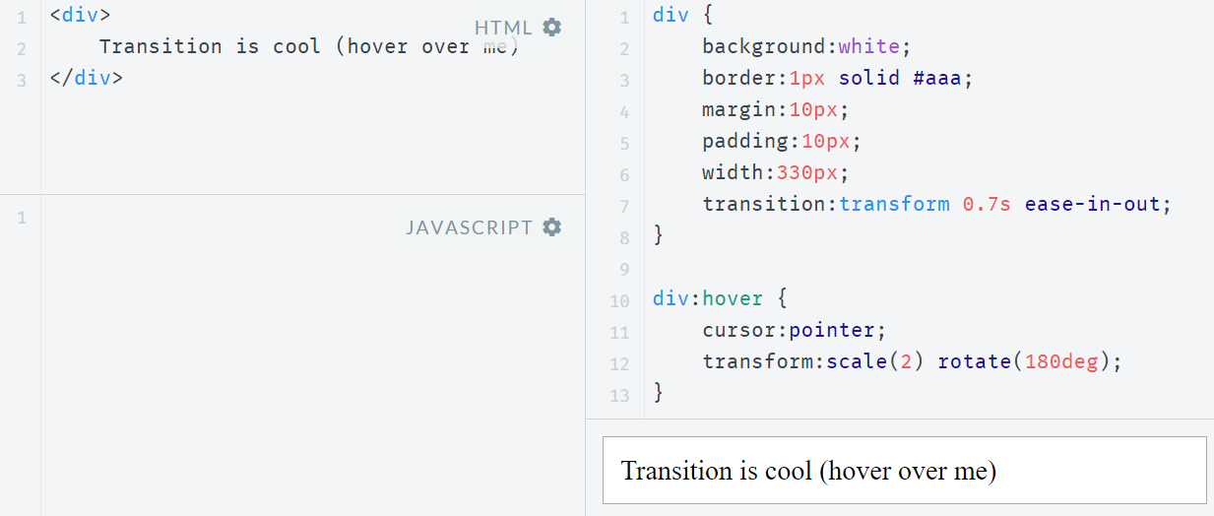
Transition Sample
http://jsfiddle.net/koldovsky/PkJaD/357/

Slide 32
CSS Animation
CSS animations animates transitions between CSS styles to another.
Consist of two components: a style describing the CSS animation and a set of keyframes that indicate the start and end states of the animation's style, as well as possible waypoints.
There are three key advantages to CSS animations over traditional script-driven animation:
Easy to use for simple animations.
The animations run well, even under moderate system load. The rendering engine can use frame-skipping and other techniques to keep the performance as smooth as possible.
Letting the browser control the animation sequence lets the browser optimize performance and efficiency by, for example, reducing the update frequency of animations running in tabs that aren't currently visible.
Some cool samples: http://webdesign.tutsplus.com/articles/15-inspiring-examples-of-css-animation-on-codepen--cms-23937
Details: https://css-tricks.com/almanac/properties/a/animation/

Slide 33
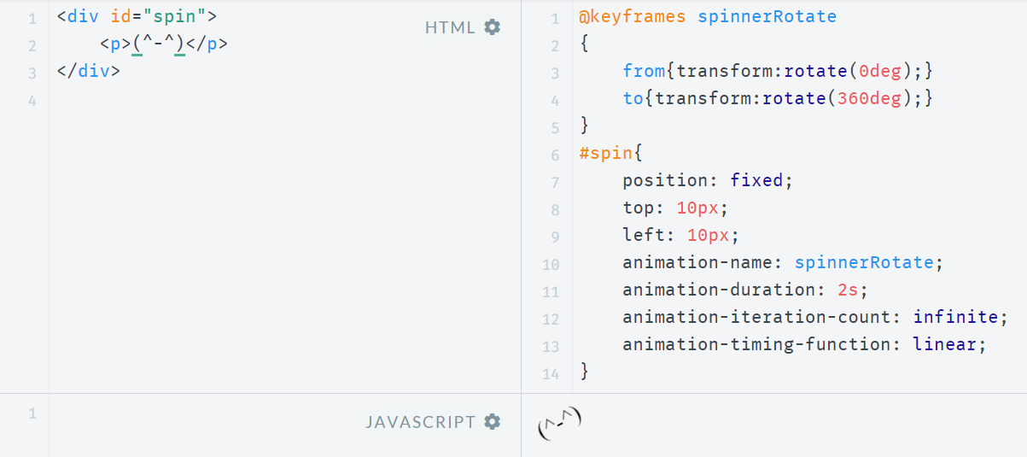
Simple Animation Example
http://jsfiddle.net/koldovsky/e2tt2mao/56/

Slide 34
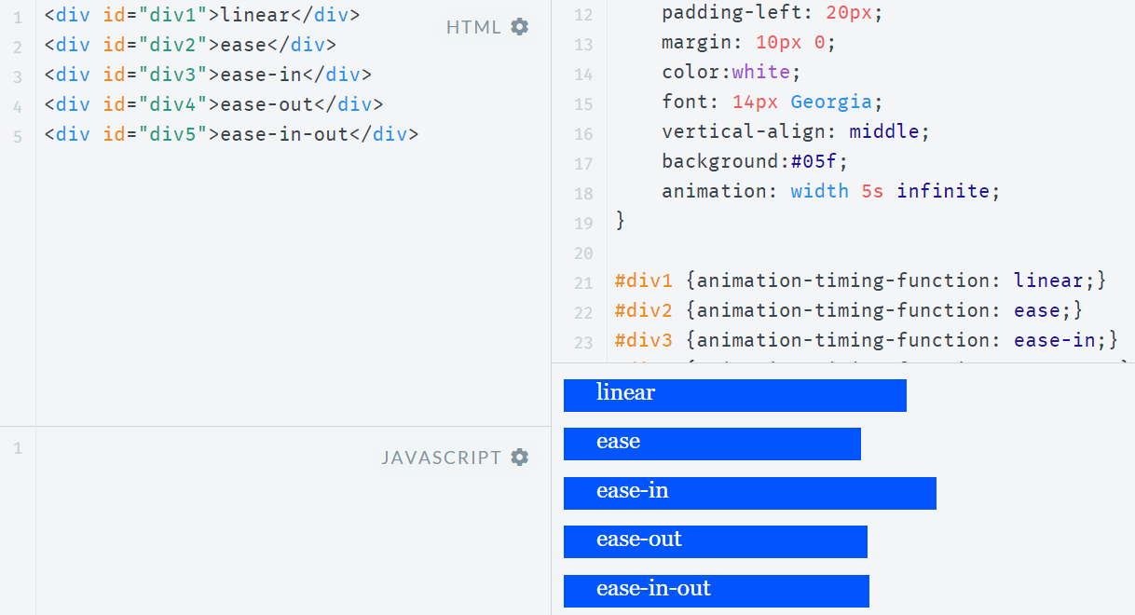
Timing Functions
https://jsfiddle.net/koldovsky/HDsw2/11/
Details: https://www.smashingmagazine.com/2014/04/understanding-css-timing-functions/

Slide 35
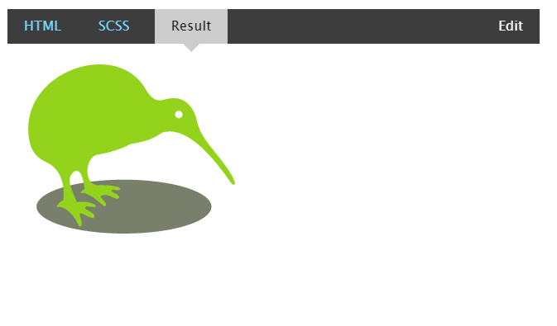
SVG Filters Support
Small file sizes that compress well
Scales to any size without losing clarity (except very tiny)
Looks great on high-res displays
An SVG filter is a set of operations that use CSS to style or otherwise modify an SVG graphic
The enhanced graphic is displayed in a browser while the original graphic is left alone.
Sample: http://codepen.io/chriscoyier/pen/evcBu
Step-by-step guide: https://css-tricks.com/using-svg/

Slide 36
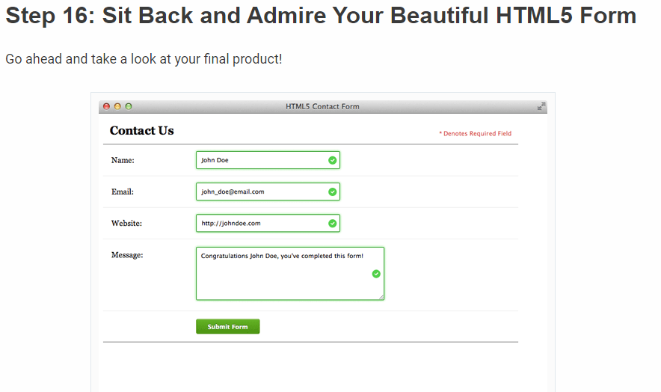
Styling forms
http://webdesign.tutsplus.com/tutorials/bring-your-forms-up-to-date-with-css3-and-html5-validation--webdesign-4738

Slide 37
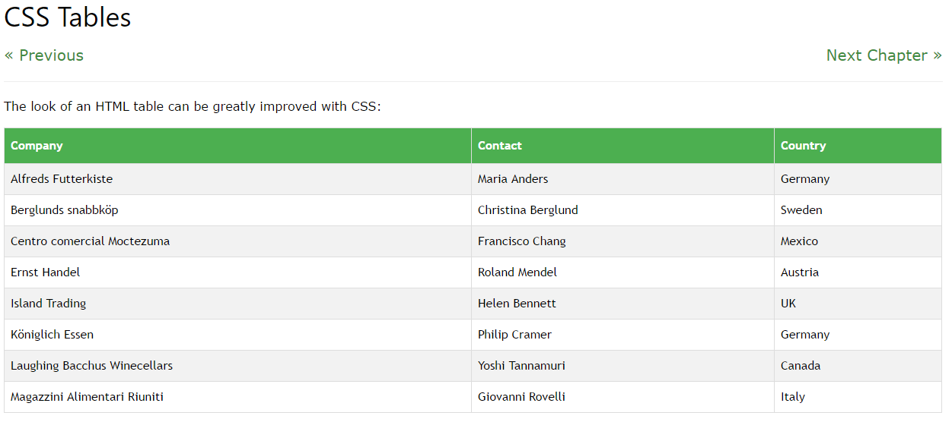
Styling Tables
http://www.w3schools.com/css/css_table.asp

Slide 38
Practice Task
Notes:
http://htmlbook.ru/practical/theme/css3
http://learn.shayhowe.com/advanced-html-css/detailed-css-positioning/
http://www.outsidethebracket.com/understanding-the-difference-between-css3-flexbox-grid-layout/
https://css-tricks.com/snippets/css/complete-guide-grid/
http://flexboxgrid.com/
https://css-tricks.com/snippets/css/a-guide-to-flexbox/

Slide 39
Advanced Topics

Slide 40
CSS Regions
Feature allows developers to dynamically flow content across multiple boxes, or containers, in HTML documents with fluid layouts
Content adjusts and displays properly whether viewed on large or small
Notes:
Tip: Add your own speaker notes here.

Slide 41
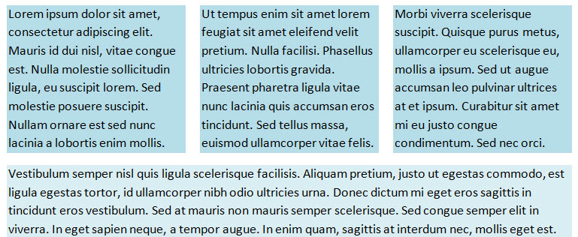
Content Flow with CSS Regions
1
2
3
Notes:
Tip: Add your own speaker notes here.

Slide 42
CSS Exclusions
Formerly referred to as positioned floats
Enables positioning of images, text, and boxes anywhere in an HTML document and wrapping of text completely around these elements
Can control the position of a float precisely, at a specified distance from the top, bottom, left, or right sides of a container
Notes:
Tip: Add your own speaker notes here.

Slide 43
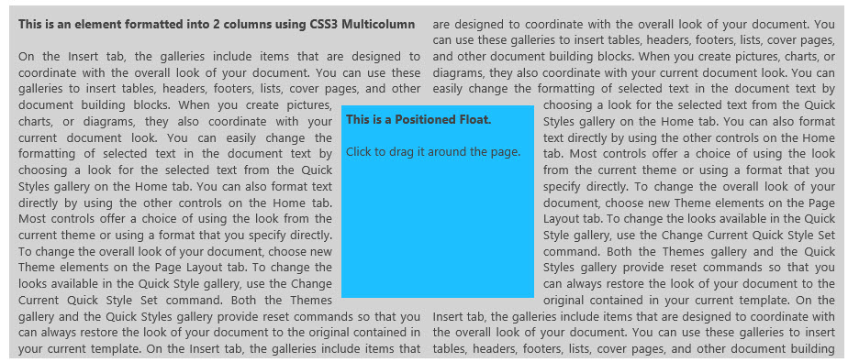
CSS Exclusions Example 1
Screen shot from Internet Explorer 10 Test Drive Web page
Notes:
Tip: Add your own speaker notes here.

Slide 44
CSS Exclusions Properties
wrap-flow:both displays content on all sides of the exclusion
wrap-flow:clear displays content above and below the exclusion but leaves the sides blank
shape-inside and shape-outside define the content and the general shape of an exclusion, respectively
-ms- vendor prefix required for Internet Explorer 10; Exclusions not supported in Internet Explorer 9
Notes:
Tip: Add your own speaker notes here.

Slide 45
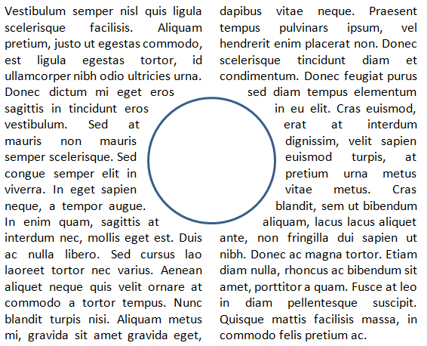
CSS Exclusions Example 2
Notes:
Tip: Add your own speaker notes here.

Slide 46
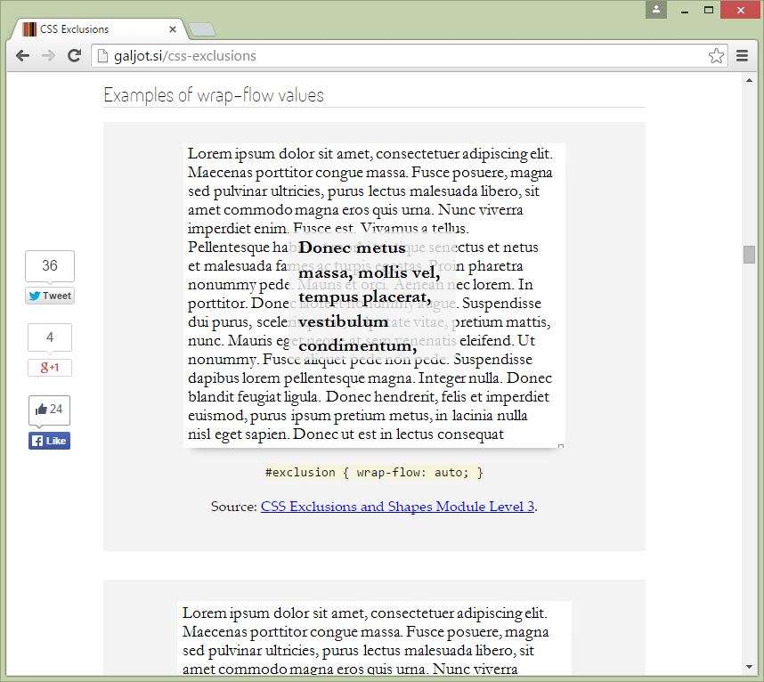
CSS Exclusions Step-by-step
Notes:
http://galjot.si/css-exclusions

Slide 47
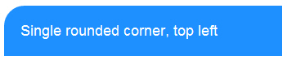
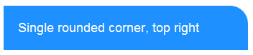
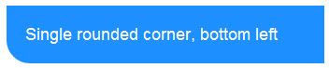
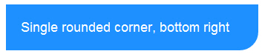
border-radius Property, Single Corners
Rounding a single corner of a box:
border-top-left-radius
border-top-right-radius
border-bottom-right-radius
border-bottom-left-radius
Notes:
Tip: Add your own speaker notes here.

Slide 48
CSS Gradient Methods
CSS3 gradient methods:
linear-gradient: Creates a gradient from top to bottom or vice versa, or from corner to corner
radial-gradient: Creates a gradient that radiates out from a central point
repeating-linear-gradient: Creates a repeating linear gradient, which results in straight bands of gradient color
repeating-radial-gradient: Creates a repeating radial gradient, which results in circular bands of gradient color
Notes:
Tip: Add your own speaker notes here.

Slide 49
Gradient Color Interpolation and Color Stops
CSS gradients support color interpolation in the alpha color space
Part of the red blue green alpha (RGBA) color model
Can specify multiple color stops, with an RGBA color and position for each one
Example of the use of rgba colors:
linear-gradient(to right, rgba(255,255,255,0)
Notes:
Tip: Add your own speaker notes here.

Slide 50
2D Translation
To translate an element means to move it without rotating, skewing, or otherwise turning the image.
Use the translate() method in CSS and provide x- and y-axis values to position the element relative to its original or default position.
x-axis value specifies the left position of the element
y-axis value specifies the top position.
Notes:
Tip: Add your own speaker notes here.

Slide 51
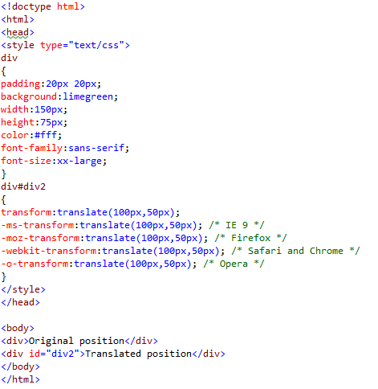
2D Translation Example
Notes:
Tip: Add your own speaker notes here.

Slide 52
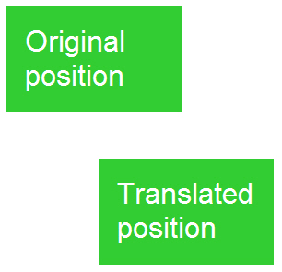
2D Translation Example
Notes:
Tip: Add your own speaker notes here.

Slide 53
2D Scaling
To scale an element is to increase or decrease its size.
Use the scale() method in CSS and provide x-axis (width) and y-axis (height) values.
The example on the following two slides increases the width of the element two times its original size, and increases the height four times its original size:
transform: scale(2,4);
Notes:
Tip: Add your own speaker notes here.

Slide 54
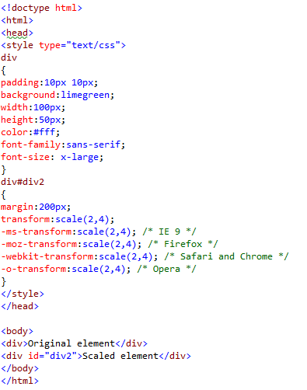
2D Scaling Example
Notes:
Tip: Add your own speaker notes here.

Slide 55
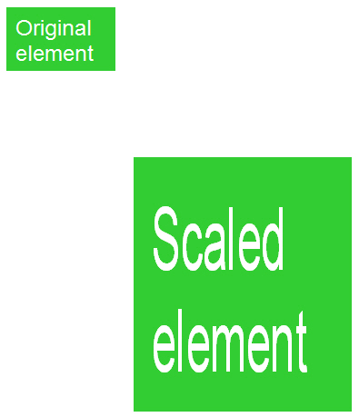
2D Scaling Example
Notes:
Tip: Add your own speaker notes here.

Slide 56
2D Rotation
To rotate an element turns it clockwise by a specified number of degrees.
Use the rotate() method in CSS and specify the degrees of rotation.
The example on the following two slides rotates an element by 30 degrees in the 2D plane:
transform: rotate(30deg);
Notes:
Tip: Add your own speaker notes here.

Slide 57
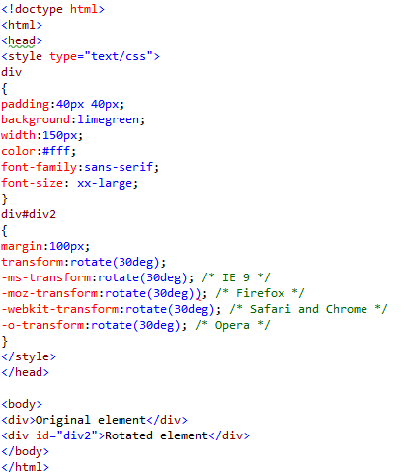
2D Rotation Example
Notes:
Tip: Add your own speaker notes here.

Slide 58
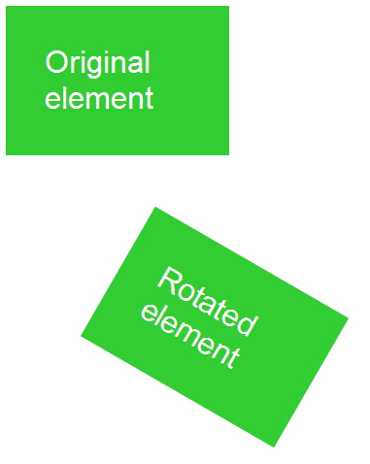
2D Example
Notes:
Tip: Add your own speaker notes here.

Slide 59
3D Rotation
3D rotation uses the rotateX() and rotateY() methods.
rotateX(): Element rotates around its x-axis
rotateY(): Element rotates around its y- axis
Notes:
Tip: Add your own speaker notes here.

Slide 60
2D Skewing
To skew an element is to stretch it in one or more directions.
Use the skew() method and provide x-axis and y-axis values, in degrees, to create an angular shape.
The example on the following two slides turns an element 20 degrees around the x-axis and 30 degrees around the y-axis:
transform: skew(20deg,30deg);
Notes:
Tip: Add your own speaker notes here.

Slide 61
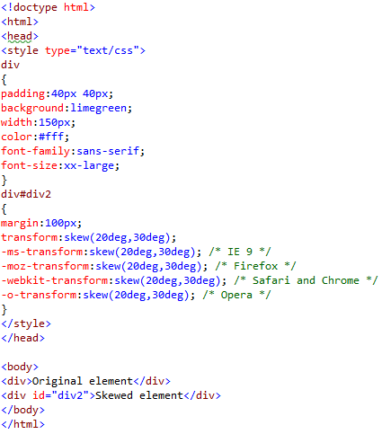
2D Skewing Example
Notes:
Tip: Add your own speaker notes here.

Slide 62
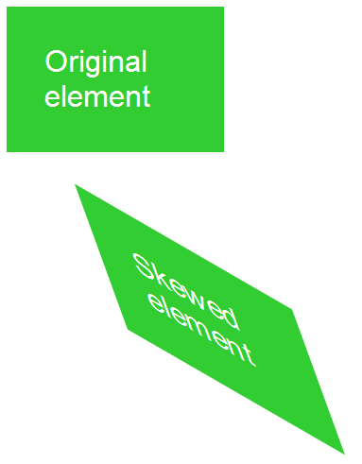
2D Skewing Example
Notes:
Tip: Add your own speaker notes here.

Slide 63
3D Skewing
3D skewing uses the skewX() and skewY() methods to skew an element around its x-axis and y-axis, respectively.
As an example, the following code skews an element 45 degrees:
transform: skewX(45deg);
Notes:
Tip: Add your own speaker notes here.

Slide 64
3D Perspective
The CSS3 3D perspective property defines how a browser renders the depth of a 3D transformed element.
The property takes on a number value: lower values (in the range of 1 to 1000) create a more pronounced effect than higher values.
Notes:
Tip: Add your own speaker notes here.

Slide 65
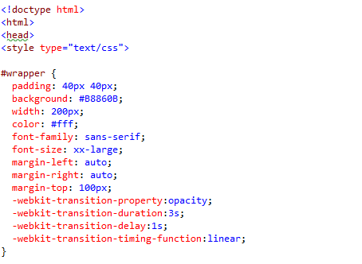
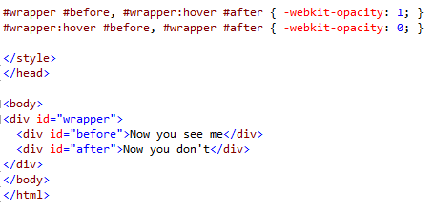
Transition Example
Notes:
Tip: Add your own speaker notes here.

Slide 66
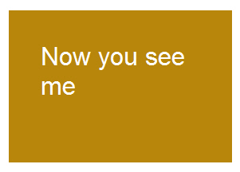
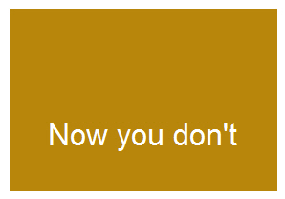
Transition Example
Transition
Notes:
Tip: Add your own speaker notes here.

Slide 67
Animation (Continued)
Specify a CSS style within the @keyframes rule
An example of a rule for a fadeout:
@keyframes fadeout {
from { opacity: 1; }
to { opacity: 0; }
}
Notes:
Tip: Add your own speaker notes here.

Slide 68
Animation (Continued)
Code snippet that configures animation properties for a fadeout:
div { animation-duration: 3s;
animation-delay: 0s;
animation-timing-function: ease; }
div:hover { animation-name: fadeout; }
Notes:
Tip: Add your own speaker notes here.

Slide 69
SVG Filters
An SVG filter is a set of operations that use CSS to style or otherwise modify an SVG graphic.
The enhanced graphic is displayed in a browser while the original graphic is left alone.
Notes:
Tip: Add your own speaker notes here.

Slide 70
SVG Filters
feBlend
feColorMatrix
feComponentTransfer
feComposite
feConvolveMatrix
feDiffuseLighting
feDisplacementMap
feFlood
feGaussianBlur
feImage
feMerge
feMorphology
feOffset
feTile
feTurbulence
feDistantLight
fePointLight
feSpecularLighting
feSpotLight
Notes:
Tip: Add your own speaker notes here.

Slide 71
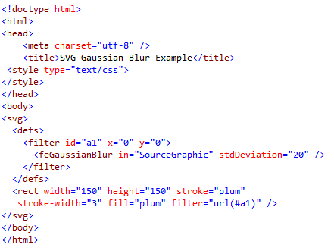

SVG Filters Gaussian Blur Example
Notes:
Tip: Add your own speaker notes here.

Slide 72
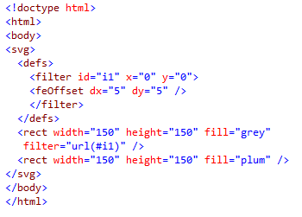

SVG Filters Offset Example
Notes:
Tip: Add your own speaker notes here.

Slide 73
Canvas
Use canvas to draw pixel-based shapes.
The canvas element accepts only two attributes—height and width.
You can use most CSS properties to style the canvas element, adding color, gradients, pattern fills, transformation, animation, and much more.
Notes:
Tip: Add your own speaker notes here.

Slide 74
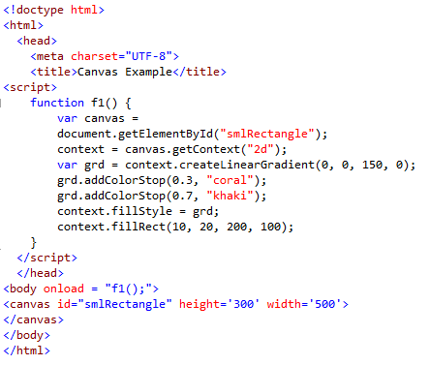

Canvas Example 1
Notes:
Tip: Add your own speaker notes here.

Slide 75
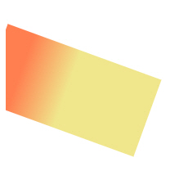
Canvas Example 2
context.rotate(20*Math. PI/180);
Notes:
Tip: Add your own speaker notes here.

Slide 76
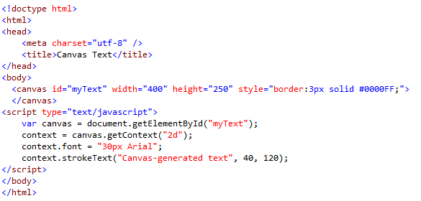
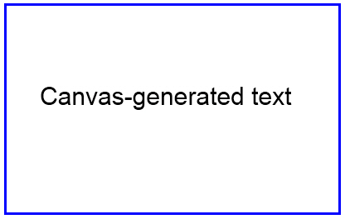
Canvas Example 3
Notes:
Tip: Add your own speaker notes here.

Slide 77
Contacts
Europe Headquarters
52 V. Velykoho Str.
Lviv 79053, Ukraine
Tel: +380-32-240-9090 Fax: +380-32-240-9080
E-mail: info@softserveinc.com
Website: www.softserveinc.com
US Headquarters
12800 University Drive, Suite 250 Fort Myers, FL 33907, USA
Tel: 239-690-3111 Fax: 239-690-3116
Thank You!
Copyright © 2010 SoftServe, Inc.

